Slide 1
Medical Image Tamper Detection Using MobileNet
Akhila Nomula - 700759384
Bhargavi Dandu - 700741185
Yallanki Harsha Sai - 700739667

Slide 2
Roles/Responsibilities and Contribution in project
Each member of the group has contributed to related research articles that are similar to this one and has acquired all the information required to work on this project.
Following the completion of the information gathering process, we moved directly to the next process of evaluation and discovered the data set on Kaggle.
After downloading the dataset, started with cleaning, eliminating null values, manipulating data, and other data preparation steps in order to get the data ready for the next steps.
Once the completion of all steps, used one of the deep learning method called Mobile Net which has provided the high accuracy for this problem.

Slide 3
Motivation
Medical imaging plays a vital role in modern healthcare, aiding in accurate diagnoses, treatment planning, and monitoring of various medical conditions.
The authenticity and integrity of medical images are of paramount importance to ensure patient safety and appropriate medical decisions.
However, the rapid advancement of deep learning techniques has brought about new challenges in the form of tampered medical images, commonly known as “deepfakes”.
The motivation lies in emphasizing the need for reliable techniques to detect manipulated medical images to prevent potential misuse of deep learning for malicious purposes.

Slide 4
Objectives
The overarching goal of this research is to develop a deep learning-based solution for the detection of tampered medical images. The specific objectives are threefold:
To create and implement a comprehensive deep learning framework capable of effectively detecting manipulated cancer regions within medical CT scans.
To evaluate the performance of a range of classification algorithms in the context of medical image tamper detection. By comparing various algorithms, we aim to identify the most suitable approach for accurate classification.
To analyze and quantify the accuracy, precision, recall, and F1-score of the developed models. These metrics will provide insights into the strengths and limitations of the proposed solution, helping us understand its overall effectiveness in tamper detection scenarios.

Slide 5
Related Work
The detection of tampered medical images is a critical concern in ensuring the integrity and reliability of medicaldiagnoses and treatments.
Over the years, researchers have proposed various approaches to tackle this challenge. Early methods often relied on watermarking and digital signatures to embed information within images for authentication.
However, their success hinges on the ability to discern subtle differences between authentic and manipulated content.
Despite advancements, these methods exhibit limitations when dealing with deepfake imagery. The use of generative adversarial networks (GANs) to create highly realistic deepfakes has made it challenging to identify manipulated content solely based on pixel-level analysis.

Slide 6
Problem Statement
The primary focus of this research is to address the challenge of differentiating between real and fake cancers within medical CT scans.
The manipulation of 3D CT scans of human lungs to alter the presence or absence of cancer necessitates the development of advanced techniques to detect these alterations.
The rise of tampering techniques that create convincing deepfakes complicates the identification of manipulated regions.
The core problem is to design a solution capable of accurately detecting these manipulated areas within the complex and intricate structure of CT scans.

Slide 7
Proposed Solution
A series of thin deep neural network architectures called MobileNet, developed by Google researchers in 2017 was created with the purpose of effectively completing tasks related to object detection and picture classification, particularly on devices with limited resources such as mobile phones and edge devices.
It addresses the challenge of deploying deep neural networks on mobile devices by striking a balance between model accuracy and computational efficiency.
The architecture consists of convolutional blocks for low-level feature extraction and inverted residual blocks for capturing complex patterns. They are flexible and customizable, with versions like MobileNetV1, MobileNetV2, and subsequent releases offering different configurations.
F1-score, the harmonic mean of precision and recall, provides a balanced metric for assessing model performance with importance given to both false positives and false negatives.
The confusion matrix, a crucial tool, visually summarizes classification algorithm performance by detailing true positives, true negatives, false positives, and false negatives, offering insights into where the model excels and where improvements are needed in tamper detection.

Slide 8
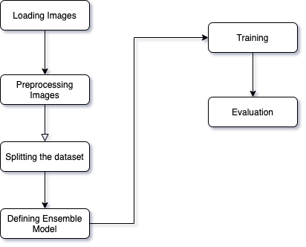
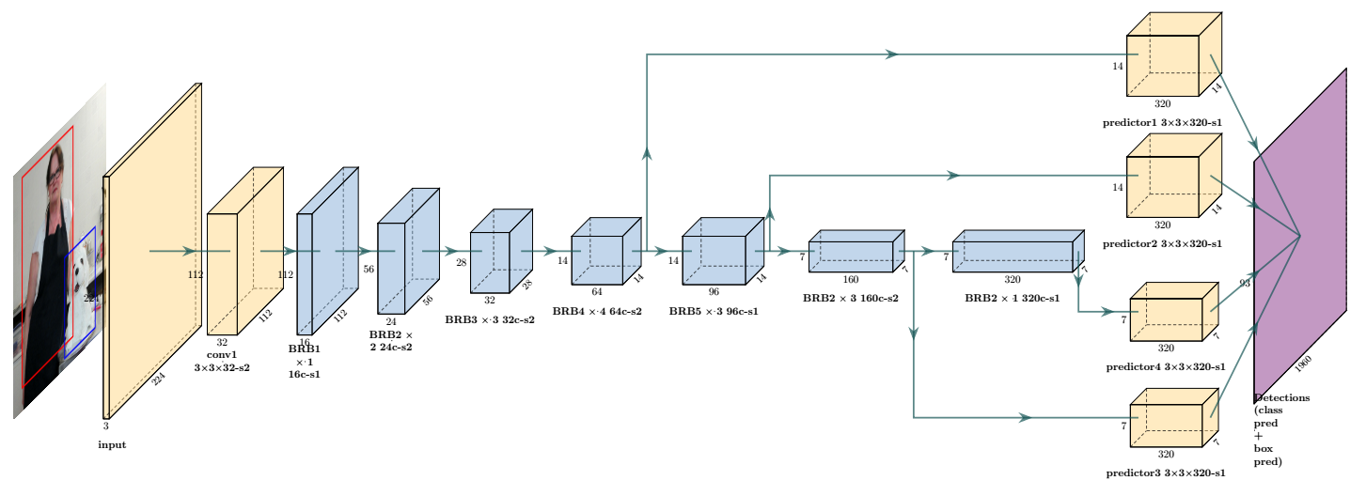
Proposed Solution
Fig - MobileNet workflow
Fig - Network architecture of MobileNet model

Slide 9
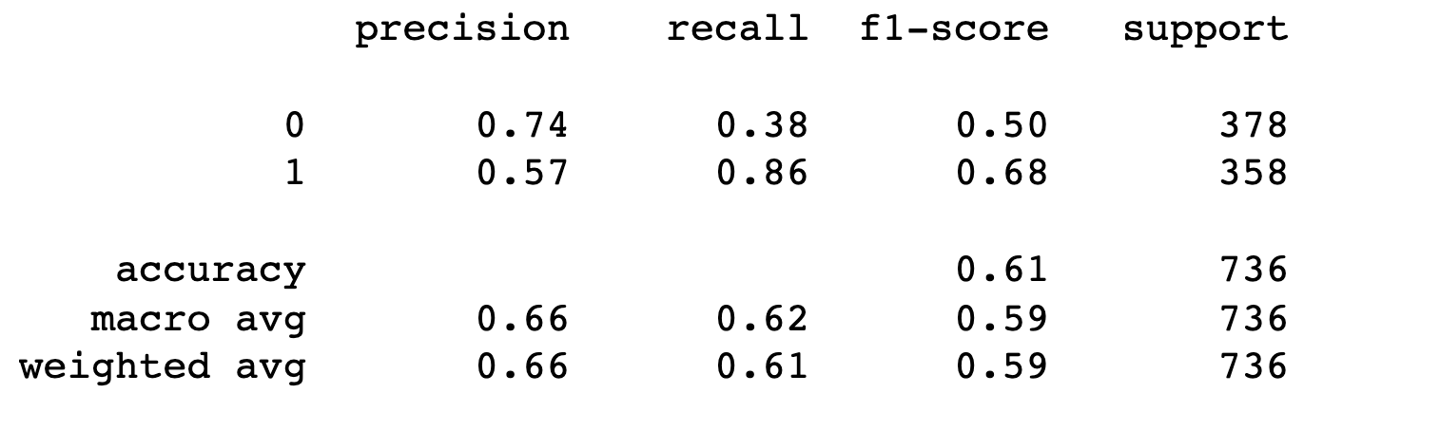
Results
The evaluation of the MobileNet method across different image features reveals its superior performance compared to other learning methods.
The average accuracy, sensitivity, and specificity rates of 66 percent, 67 percent, and 67 percent, respectively, highlight the Robustness and effectiveness of the MobileNet algorithm.
These findings position MobileNet as a promising choice for image classification tasks, especially in scenarios where a balance between accuracy and computational efficiency is crucial.
Further research and fine-tuning can potentially enhance the model's performance and applicability in a broader range of applications.

Slide 10
References
[1] R. Dixit , R. Naskar, and A. Sahoo . Copy-move forgery detect ion exploiting statistical image features, 2017 International Conference on Wireless Communications, Signal Pro cessing, and Net working (WiSPNET ), Chennai, 20 17, pp. 2277 -2281.
[2] A. J. Fridrich, B. D. Soukal, and A. J. Luk s, Detection of copy–moveorgery in digital images, in Proceedings of Digital Forensic Research Workshop , Cite seer 2003.
[3] B. Patil, S. Chapaneri, and D. Jayaswal. Improved image splicing forgery localization with first digits and Markov model features, IEEE International Conference on Intelligent Techniques in Control, Optimization and Signal Processing (INCOS), Srivilliputhur, 2 017,pp. 1-5.
[4] A. C. Popescu and H. Farid. Exposing digital forgeries by detecting traces of re-sampling. IEEE Trans. Signal Pro cessing, vol. 53, no. 2, pp.758–767, 2005.
[5] Bo Liu, Chi-Man Pun, and Xiao-Chen Yuan. Digital Image Forgery Detection Using JPEG Features and Local Noise Discrepancies. Hindawi Publishing Corporation, Scientific World Journal.
Ritu Agarwal and Om Prakash Verma, “An efficient copy move forgery detection using deep learning feature extraction and matching algorithm”, Springer Science Business Media, LLC, part of Springer Nature 2019, 23 December 2019.
Arfa Binti Zainal Abidin, Azurah Binti A Samah, Hairudin Bin Abdul Majid and Haslina Binti Hashim, “Copy-Move Image Forgery Detection Using Deep Learning Methods: A Review”, 978-1-7281-6726-8/19/$31.00 2019 IEEE.
Gul Muzaffer and GuzinUlutas, “A new deep learning-based method to detection of copymove forgery in digital images”, 978-1-7281-1013-4/19/$31.00 2019 IEEE.
http://dx.doi.org/10.1155/2014/230425.

Slide 11
THANK YOU

